Slide 1
Network Analysis and Design
Lab 2
Rehab Hosny

Slide 2

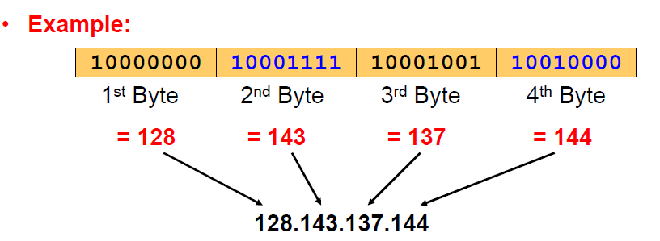
IP addressing
The network prefix identifies a network and the host number identifies a specific host (actually, interface on the network).

Slide 3
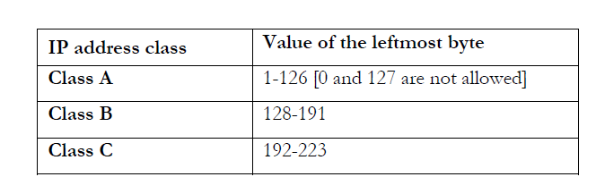
IP address classes
IP addresses are divided into different classes. These classes determine the maximum number of hosts per network ID. Only three classes are actually used for network connectivity. The following table lists all of the address class.

Slide 4
Default Subnet mask
it is used to identify the network part from the host part. Put binary one for the parts that represent network part and zero for the part that represent host part.
a. Class A: 255.0.0.0
b. Class B: 255.255.0.0
c. Class C: 255.255.255.0
We can’t have mix of 1s and 0s in subnet mask. Only consecutive 1s is followed by consecutive 0s

Slide 5
Number of hosts per classes
Class | Default mask | Hosts
Class A | 255.0.0.0 | 16777217
Class B | 255.255.0.0 | 65534
Class C | 255.255.255.0 | 254

Slide 6
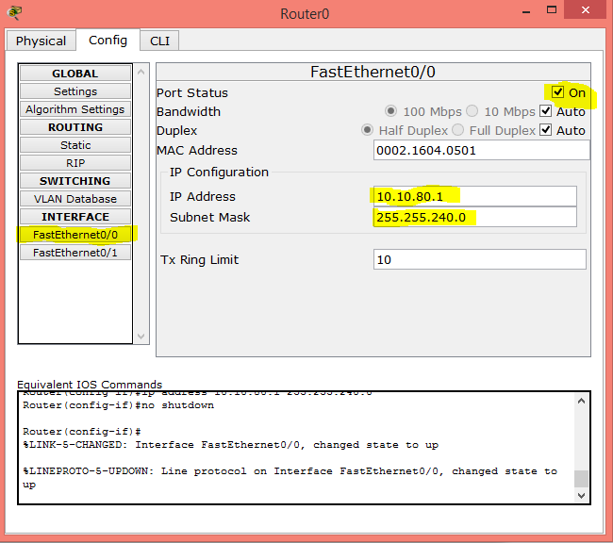
Configur router

Slide 7
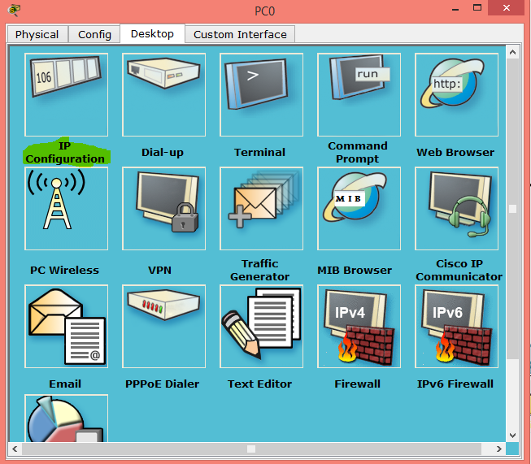
Configure PC

Slide 8
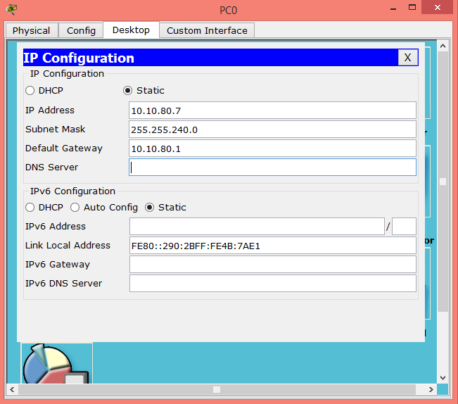
Configure PC

Slide 9
How to configure Dynamic IP
By using DHCP this allow router to give dynamic IP to devices in network.
We can configure it in router or by using server
DHCP refers to Dynamic Host Configuration Protocol

Slide 10
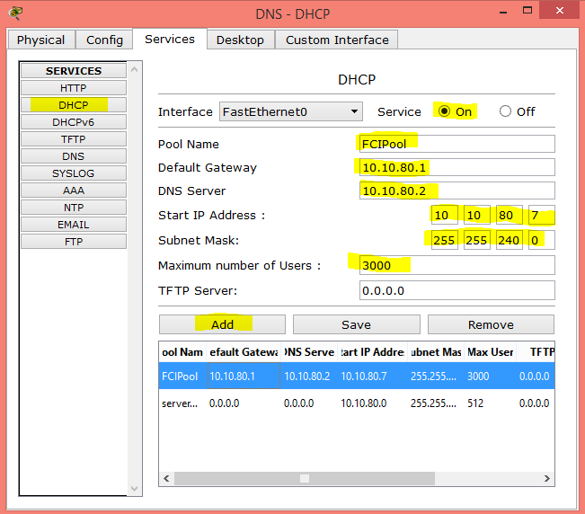
Configure DHCP on Server

Slide 11
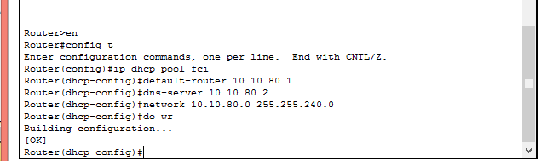
Configure DHCP on Router

Slide 12
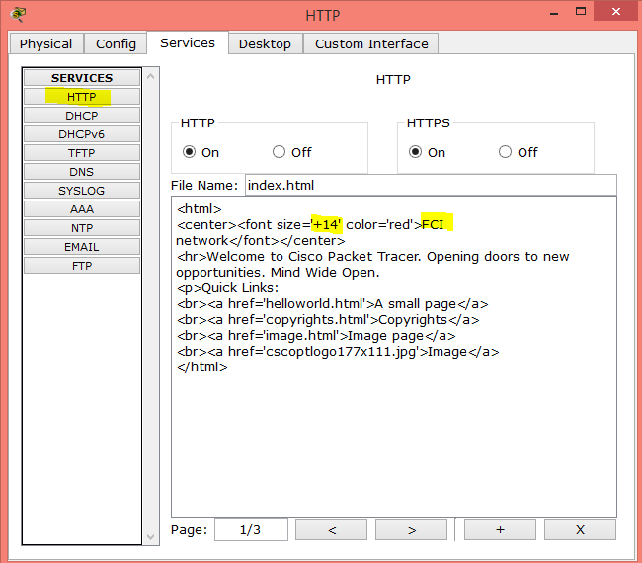
Configure HTTP service on server

Slide 13
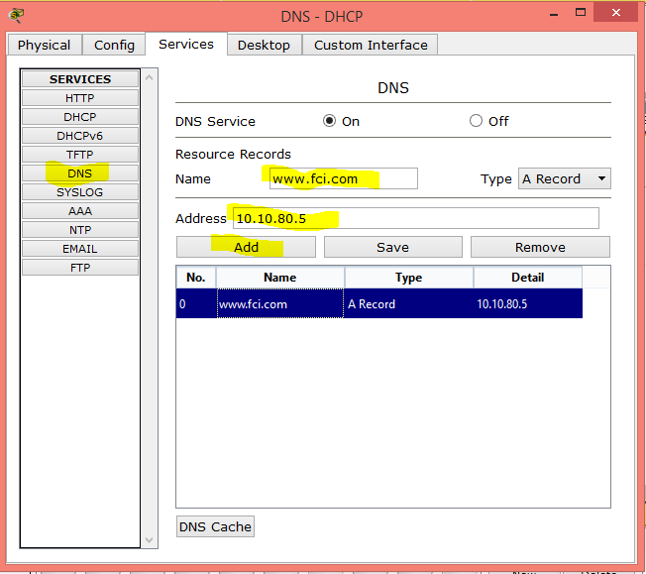
Configure DNS on server

Slide 14
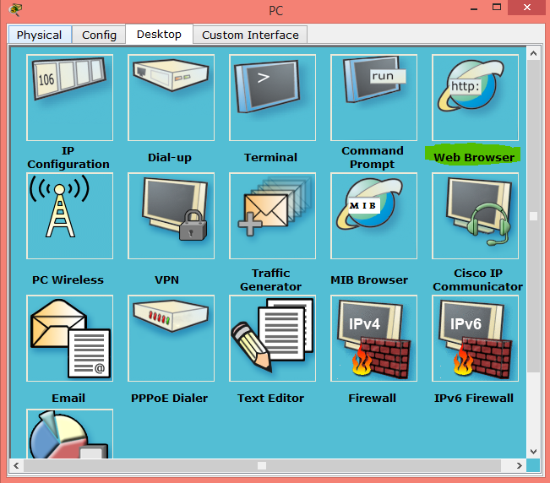
Connect to website (Step 1)

Slide 15
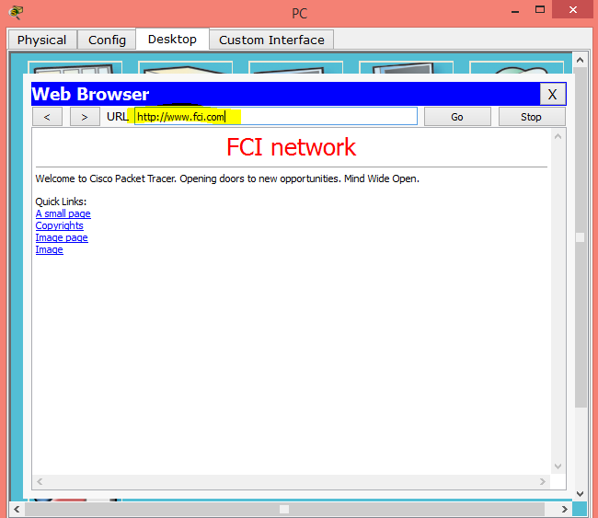
Connect to website (Step 2)

Slide 16
END

